Slide 1
Dimensionality reduction
Dimensionality reduction is a key technique in modern data science and machine learning that addresses the challenges posed by high dimensional datasets.
As the number of input features increases, data becomes sparse and models become prone to overfitting, reduced interpretability, and longer training times — this is known as the curse of dimensionality.
Reducing dimensions is essential for improving model performance, simplifying data visualization, and enhancing generalization.

Slide 2
Principal Component Analysis (PCA)
Principal Component Analysis (PCA), is one of the most widely used techniques for dimensionality reduction in machine learning and data science.
When working with high-dimensional datasets, it becomes difficult to interpret, visualize, and efficiently model the data.
PCA addresses this by transforming the data into a new coordinate system where the axes (called principal components) are ordered by the amount of variance they capture from the original data.

Slide 3
Dimensionality reduction-example
Imagine you are managing the library of an engineering college.
Each book in the library has multiple attributes:
  • Title,
  • Author,
  • Number of pages,
  • Publication year,
  • Subject,
  • Semester it belongs to, and even the
  • Color of its cover.

Slide 4
Dimensionality reduction-example
Dimensionality reduction techniques like PCA help automatically identify which features (like subject and syllabus coverage) vary the most with semester classification.
It then reduces the number of dimensions by projecting the data into a space that highlights the most informative patterns
Just like how you might reorganize the library shelves to reflect the semester-wise need while ignoring less useful details.

Slide 5
PCA
Suppose you are building a simple machine to distinguish between apples and oranges using only two features:
• The radius of the fruit and
• The intensity of the red color.
When you plot the data, you observe that all fruits have roughly similar radii but differ significantly in their red color intensity.

Slide 6
PCA
Since color shows greater variation than radius, the color feature carries more information for distinguishing the fruits.
PCA would choose to project the data onto the axis corresponding to the red color, capturing the most variance and thus the most distinguishing information

Slide 7
Benefits of Dimensionality Reduction
Simplifies models → Fewer features to analyze.
  [Library: You don’t have to consider color, weight, or font style of books — just the title.]
Faster learning → Less data processing required.
  [Library: Organizing a book is faster when you focus on just the title.]
Better generalization → Removes irrelevant/noisy features.
  [Library: Ignoring book cover design prevents you from making wrong assumptions about content.]
Improved visualization → Allows plotting in 2D or 3D.
  [Library: You can arrange shelves clearly — like grouping all books

Slide 8
Principal Component Analysis (PCA)
Principal Component Analysis is a statistical method that transforms a dataset into a new coordinate system such that:
  The first coordinate (PC1) captures the greatest variance.
  The second coordinate (PC2) captures the second greatest variance.
  Further components capture remaining variance in decreasing order.

Slide 9
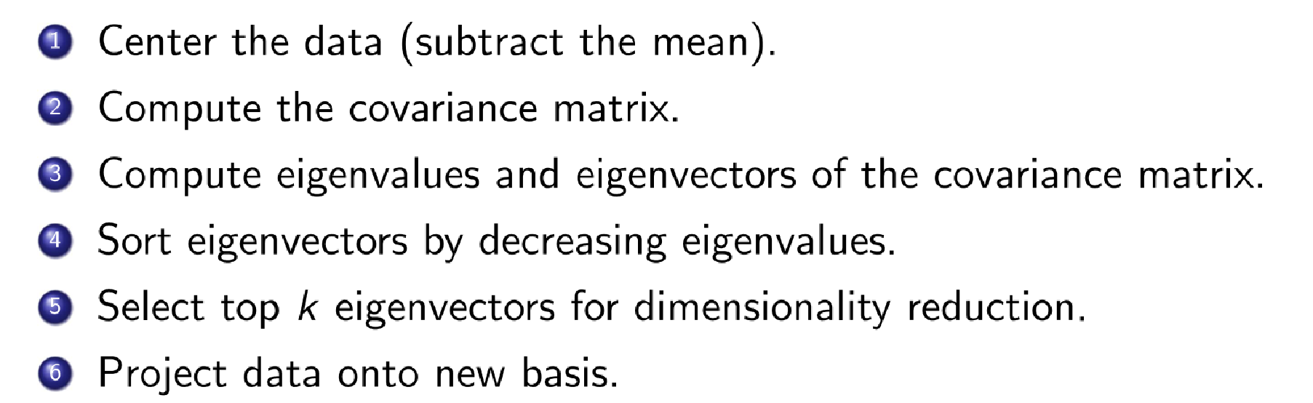
Steps in PCA

Slide 10
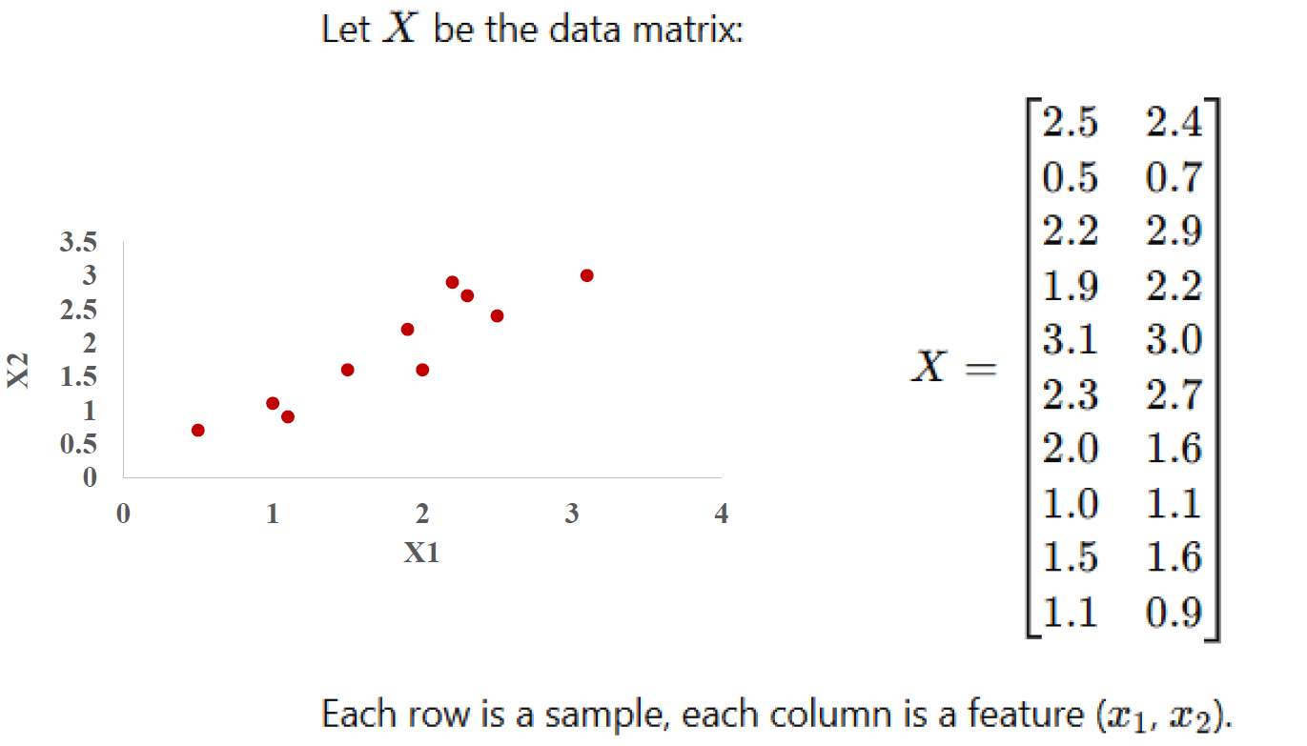
The dataset contains 2D data for 10 samples:

Slide 11
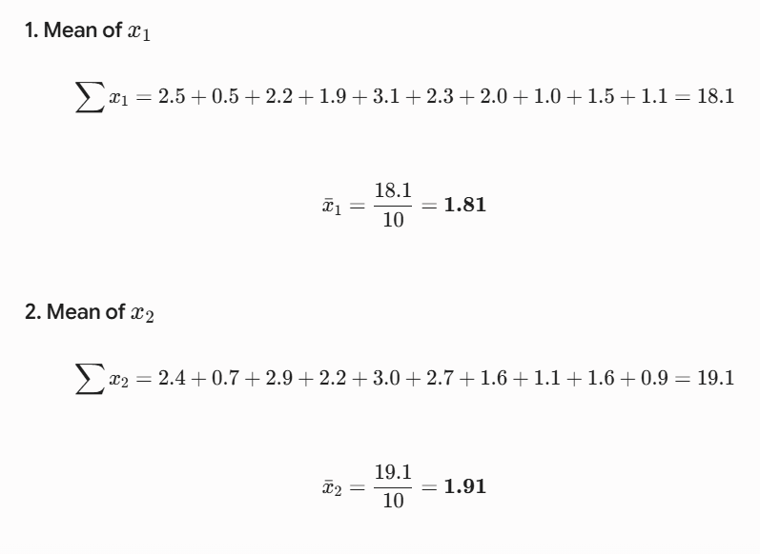

Slide 12

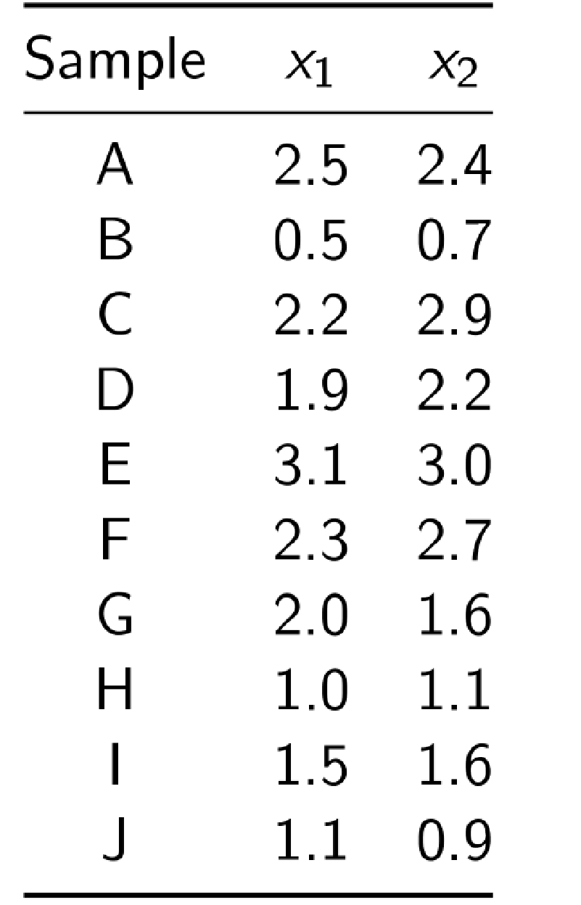
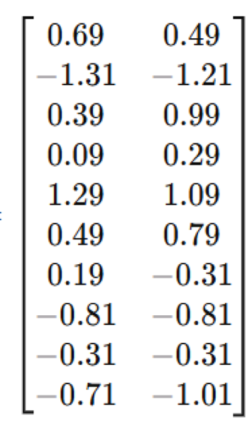


Slide 13
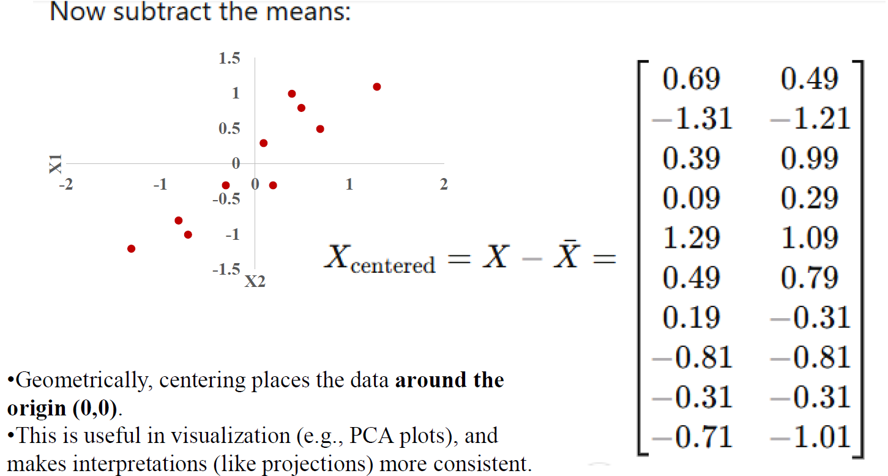

Slide 14
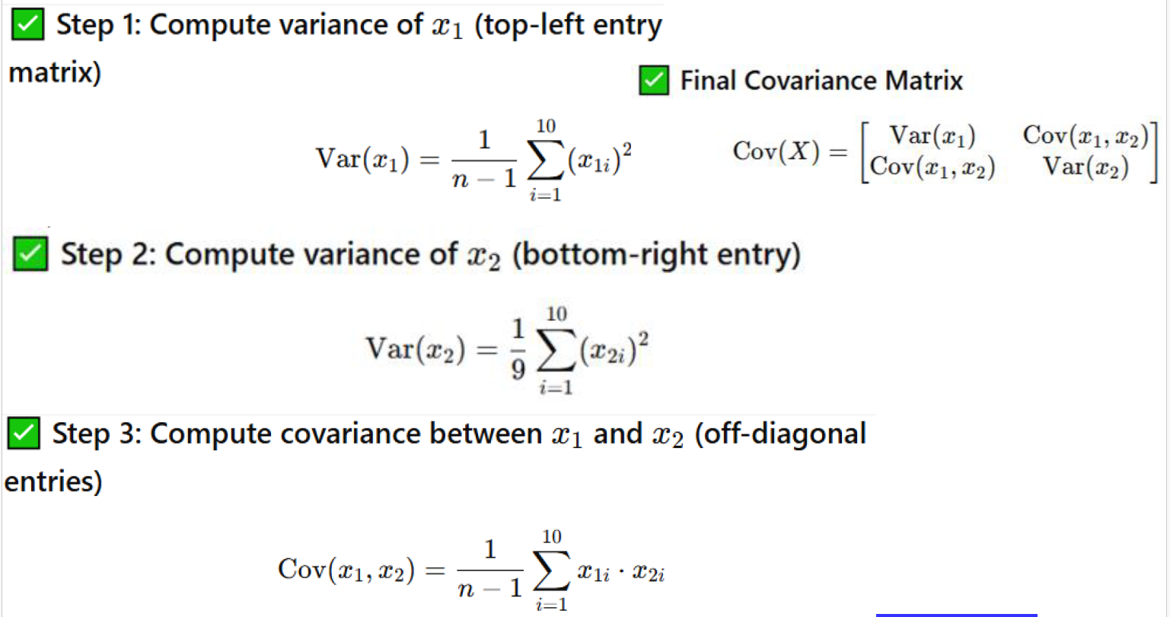

Slide 15
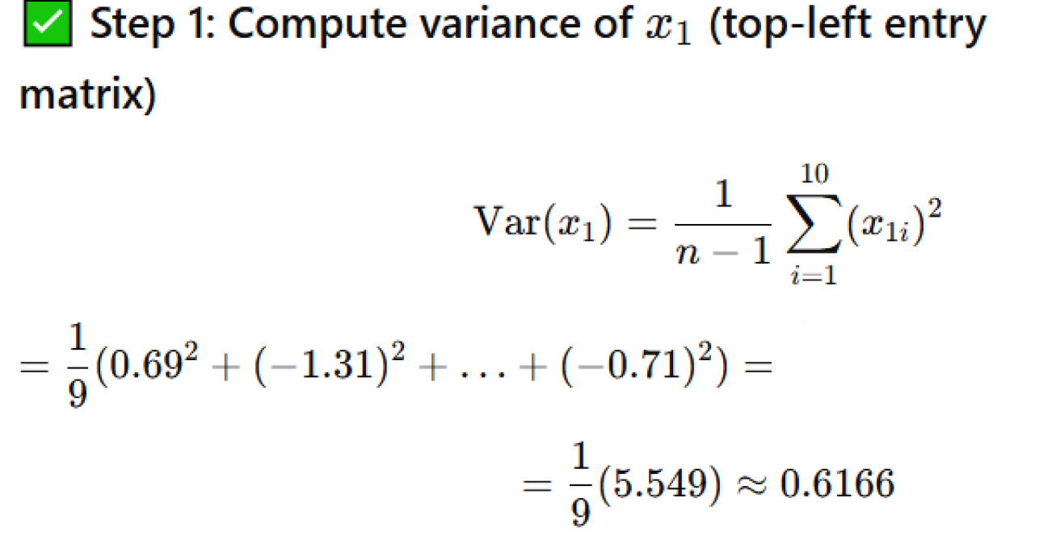

Slide 16
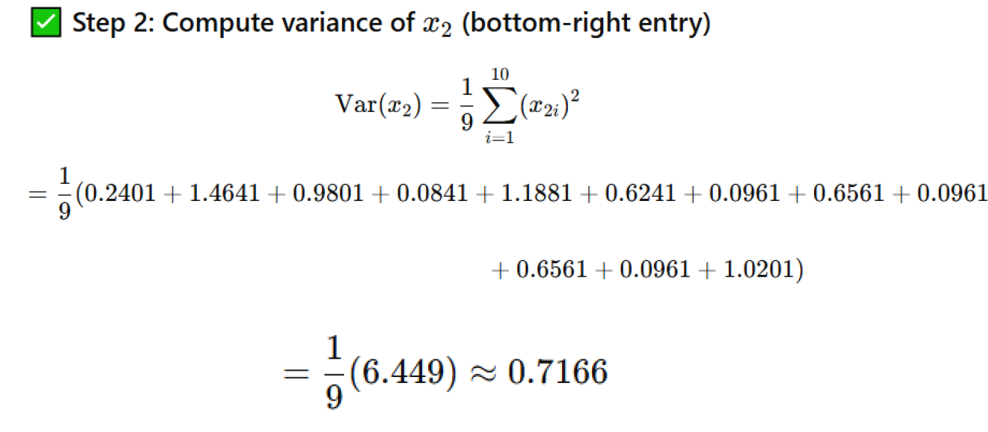

Slide 17
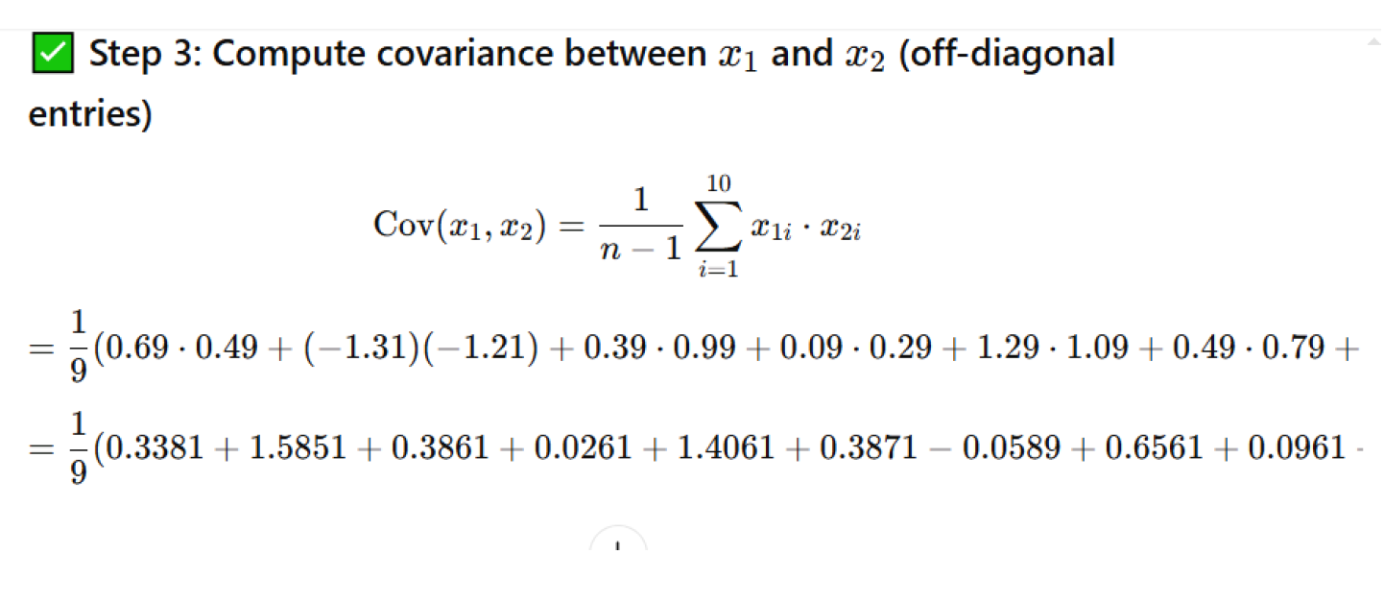

Slide 18
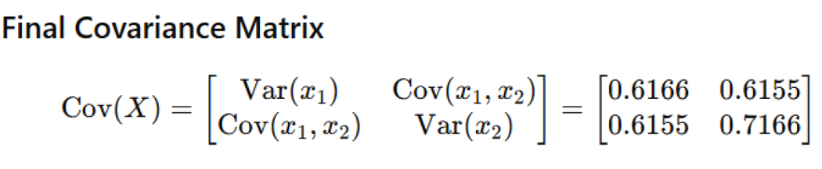
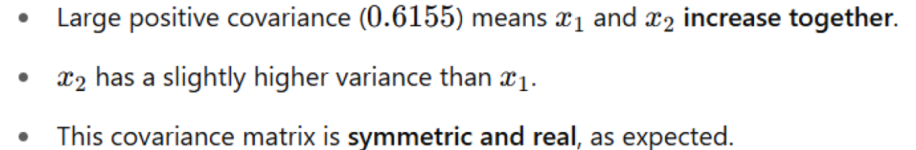

Slide 19
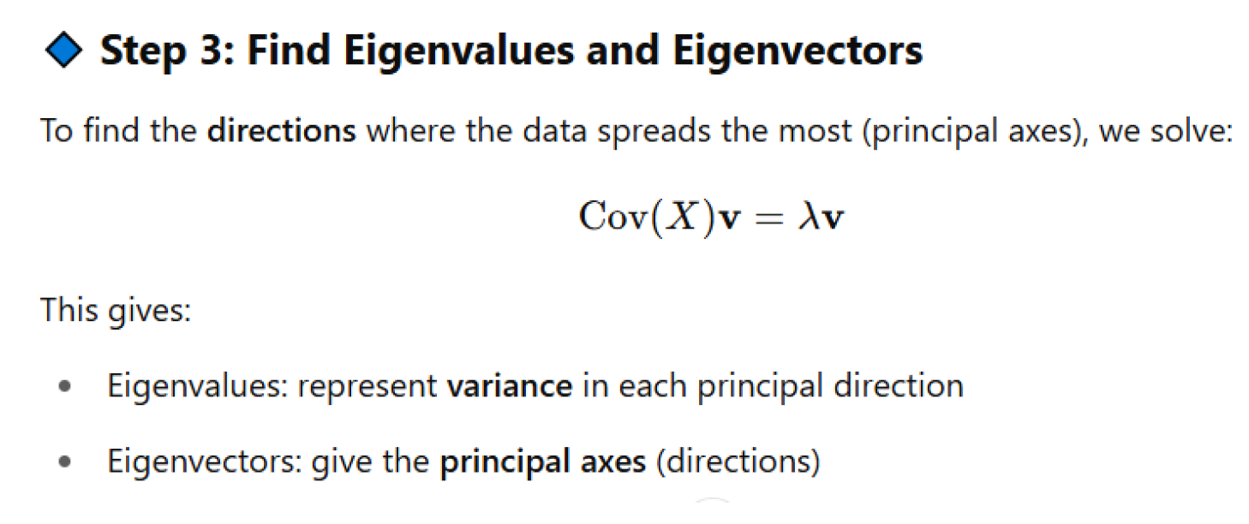

Slide 20
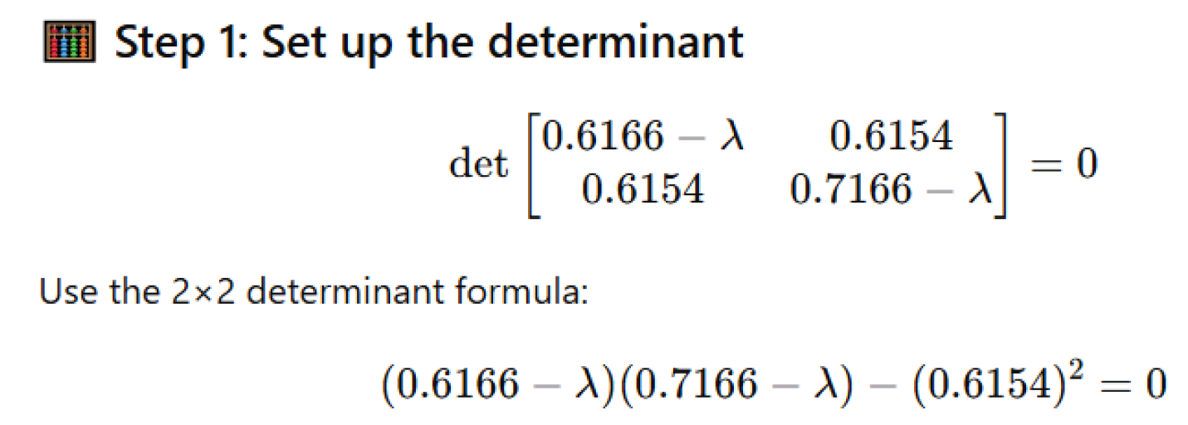

Slide 21
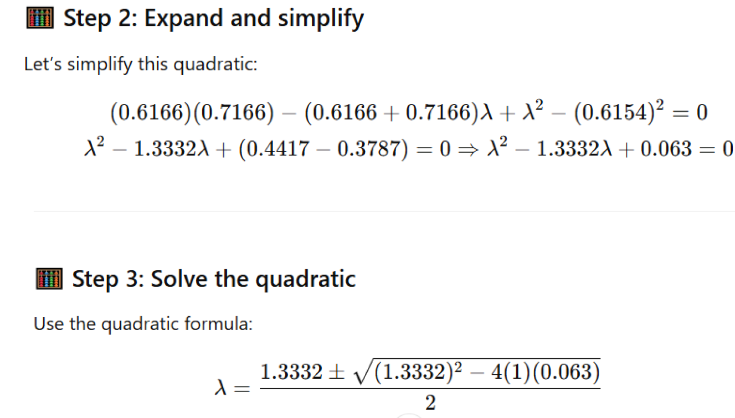

Slide 22
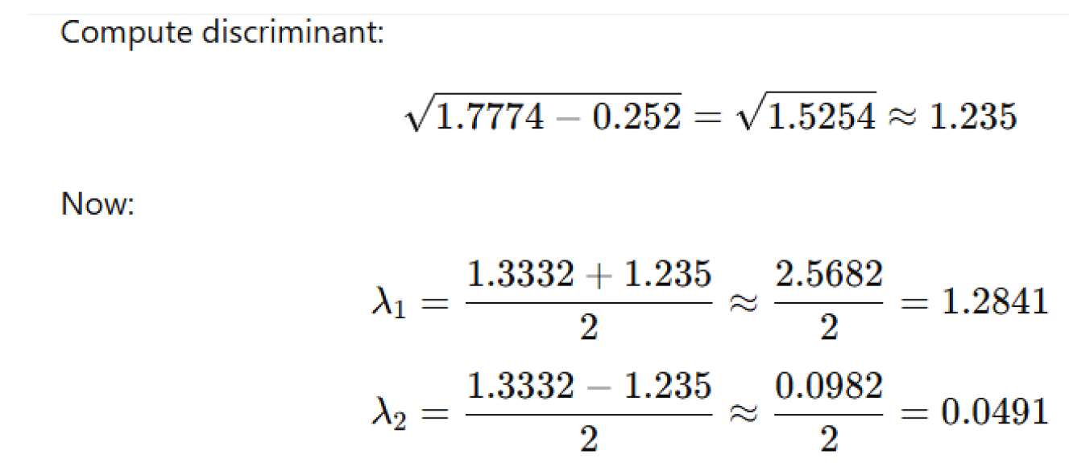

Slide 23
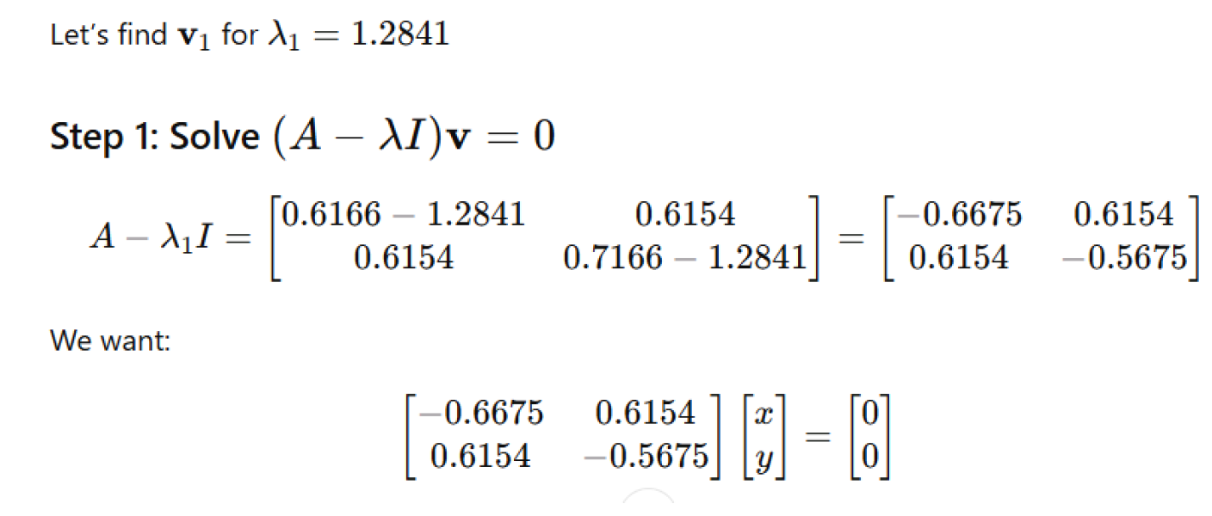

Slide 24
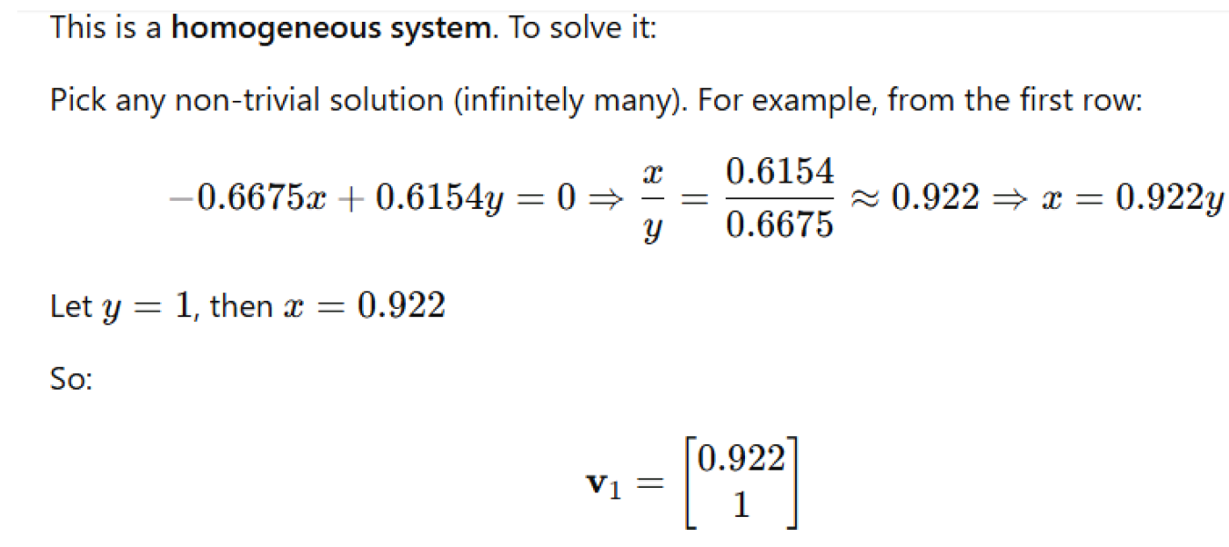
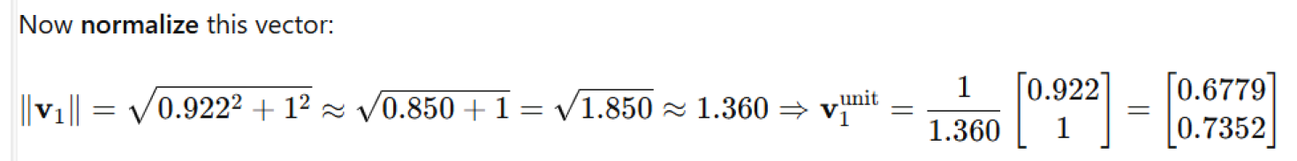

Slide 25

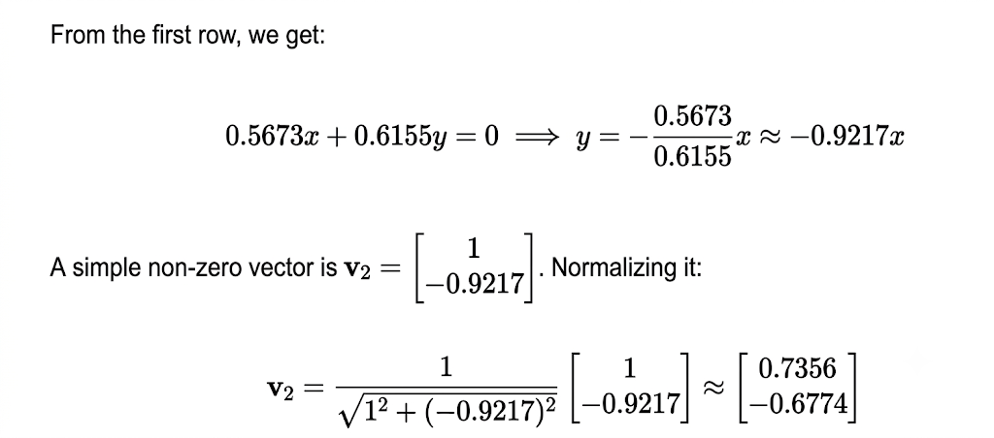

Slide 26
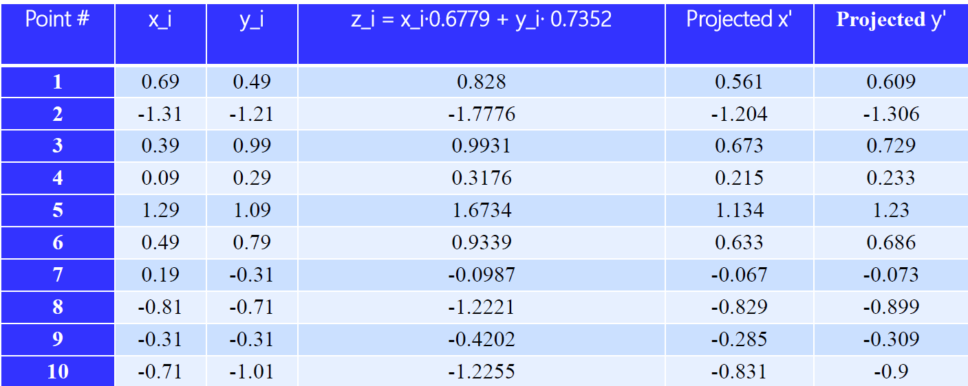
Compute first principal components
Projected Value=Xcentered​*v1​=x1*(0.6678)+x2(0.7443)

Slide 27
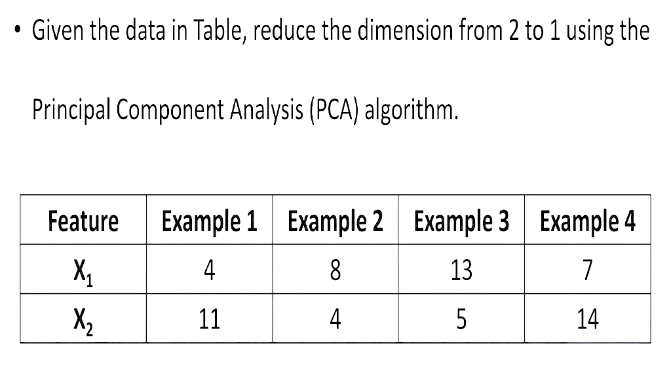
Example 2

Slide 28
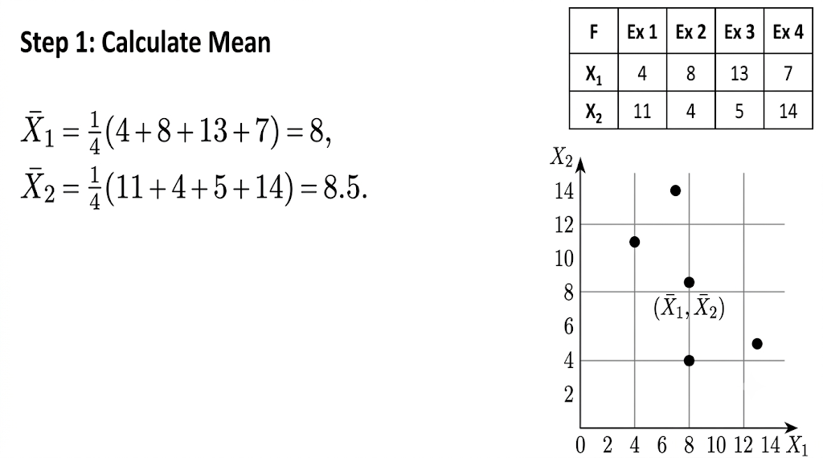

Slide 29
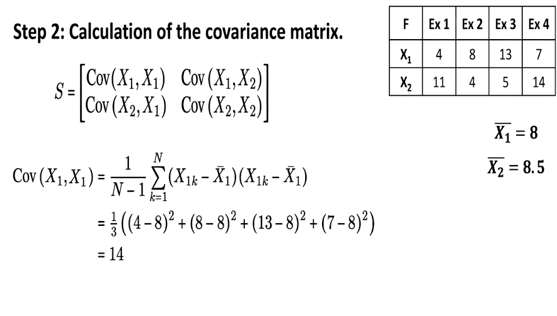

Slide 30
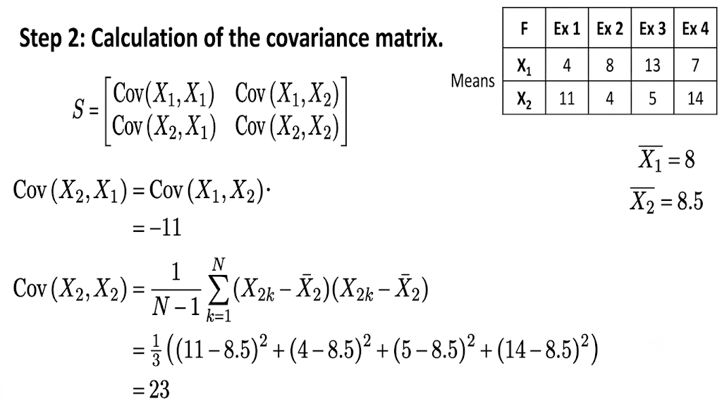

Slide 31
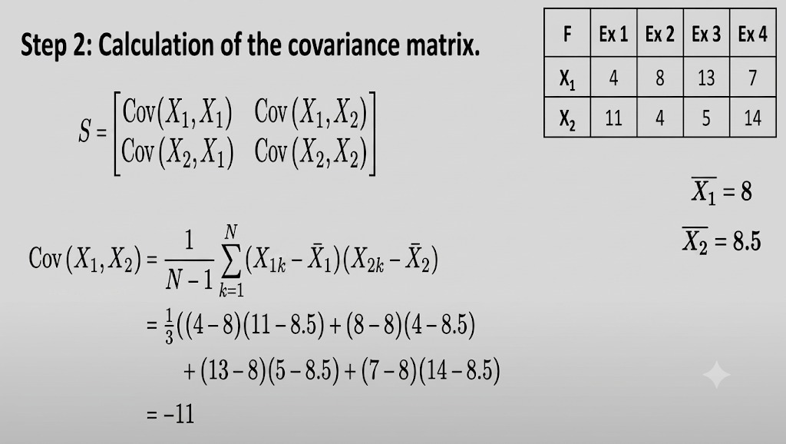

Slide 32
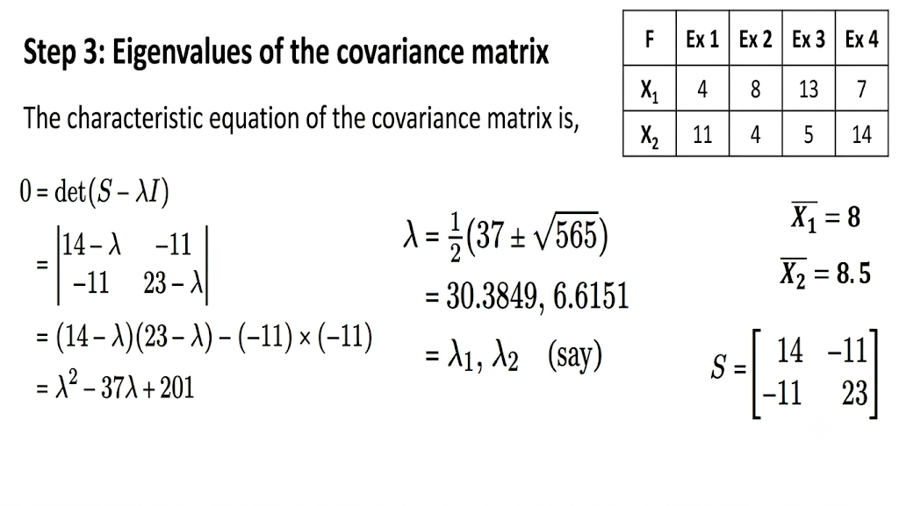

Slide 33
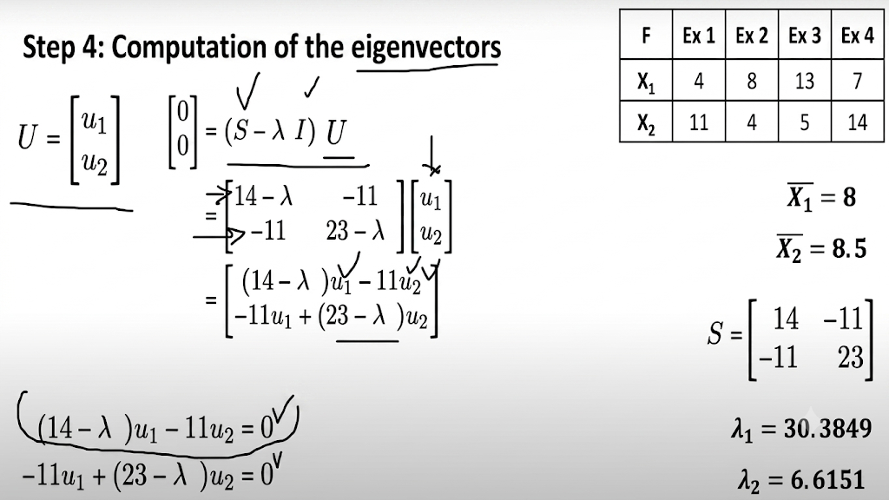

Slide 34
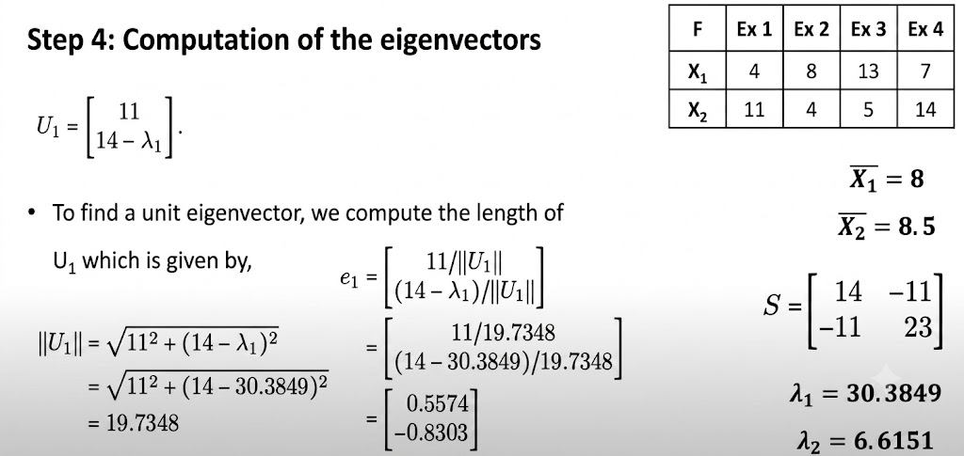

Slide 35

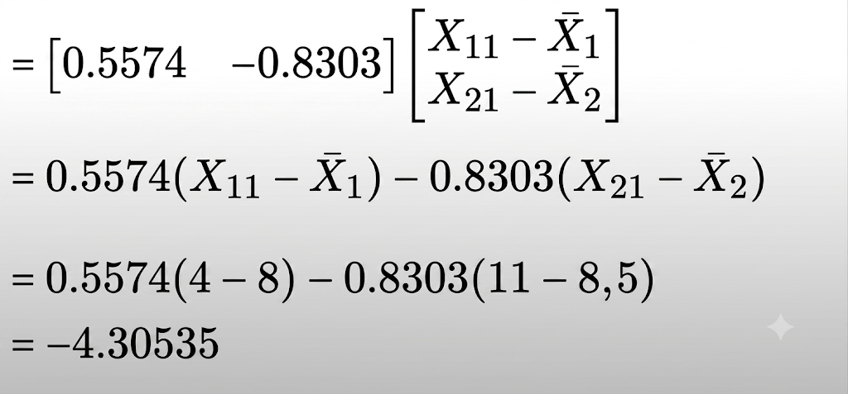

Slide 36
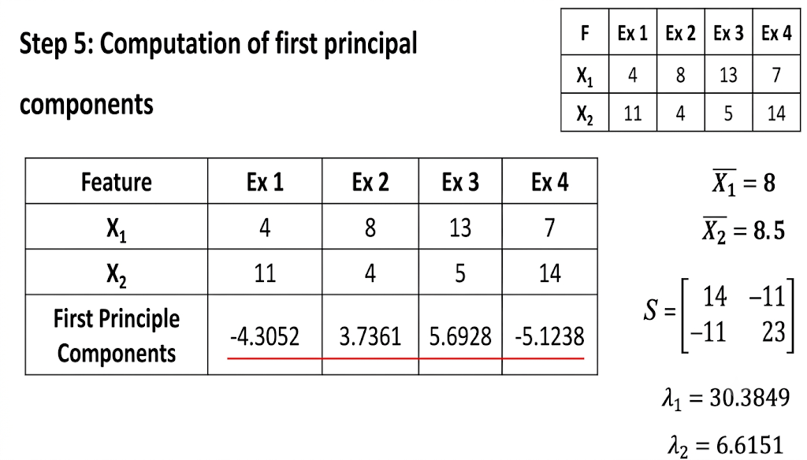

Slide 37
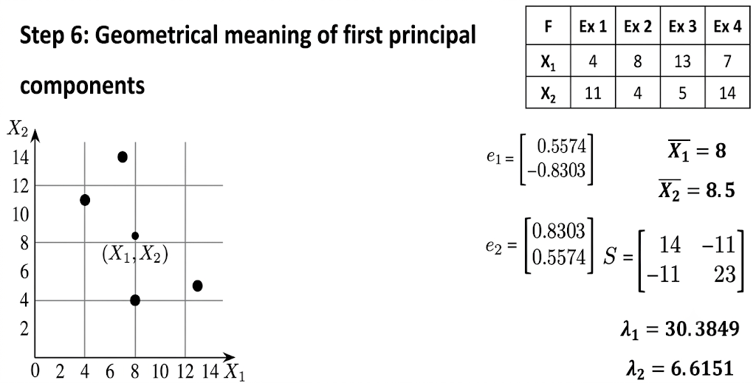

Slide 38
